Slide 1
Children’s exposure to ultraviolet radiation – a risk profile for future skin cancers in Ireland
Presentation prepared for:
Adolescent and Young People Subgroup (13-24 years)
National Skin Cancer Prevention Plan 2023-2026
08 June 2023

Slide 2
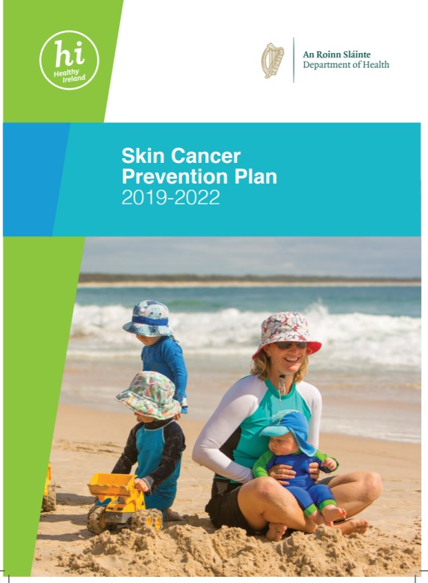
Policy Context
A report & easy read summary was developed to support the implementation of the Skin Cancer Prevention Plan 2019-2022
Action Area 3: Children and Young People
“Develop a comprehensive profile of school-children’s risk and protective behaviours relating to UV exposure to inform the implementation of the plan.”
Notes:
Within the National Skin Cancer Prevention Plan, IPH was named as a delivery body and tasked with action to develop a profile of children’s sun safety behaviours, their use of sunbeds and their experience of sunburn as noted in Action Area 3.

Slide 3
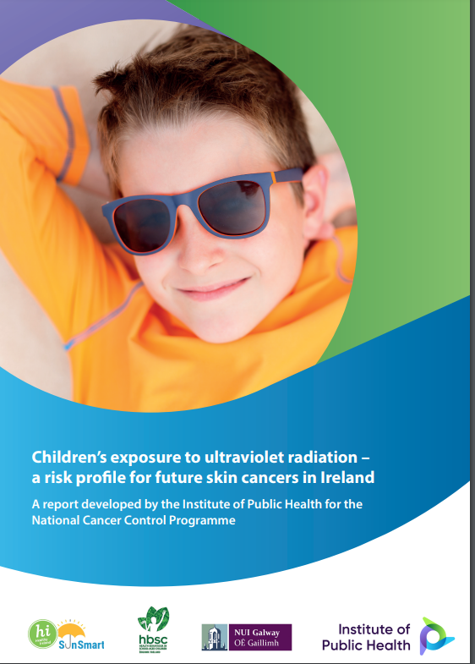
Methods
Data from multiple sources were presented including:
Health Behaviour in School-Aged Children (HBSC) Study 2018 (NUIG/ WHO)
Meteorological data
National Cancer Registry of Ireland,
Growing Up in Ireland National Longitudinal Survey of Children - Cohort 1998,
Hospital InPatient Enquiry (HIPE),
Young Persons Behaviour and Attitudes Survey 2016 and 2019
Healthy Ireland Survey 2019
3
Notes:
This led IPH to work closely with researchers at the National University of Ireland, Galway (NUIG) to configure questions for inclusion in the 2018 Health Behaviour and School-Age Children Survey – the questions were carefully piloted and revised before fieldwork began
HBSC Data provides the 1st ever self-reported population-representative data on UV protection and risk behaviors in Ireland among 10-17 year olds.
HBSC is a collaborative study with the WHO European office

Slide 4
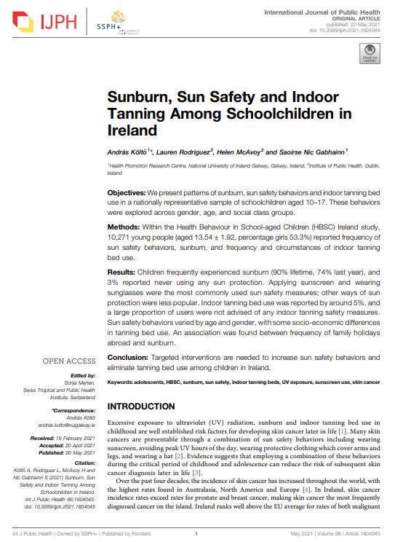
Analytic Approach
Examined data from 2018 HBSC, a collaborative study with the WHO European office
2018 HBSC data provides the first nationally representative evidence of UV-related behaviors of 10-17-year-olds.
An easy-read, blog posts, press release, and full report were published as well as a publication in the International Journal of Public Health.
4

Slide 5
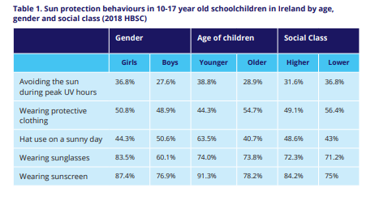
Results: Overview of UV Protection Behaviours 10-17-year-olds (HBSC 2018)
Notes:
Girls, younger children and lower social classes more likely to avoid peak UV hours
Boys, older children and lower social classes more likely to wear protective clothing
Boys, younger children and higher social classes more likely to wear sun hats
Girls and older children more likely to wear sunglasses
Girls, younger children and higher social classes more likely to report sunscreen use

Slide 6
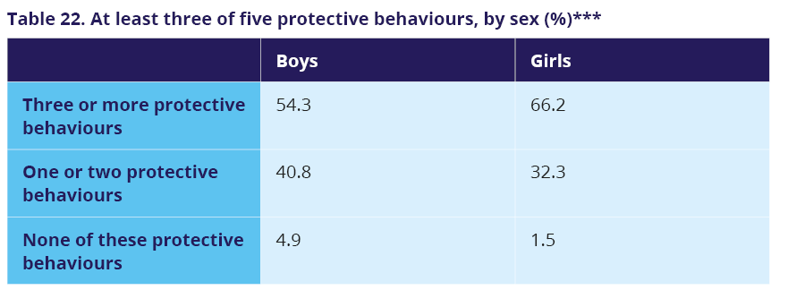
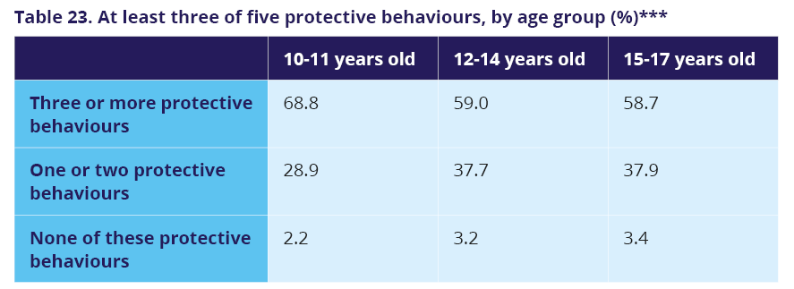
Results: Multiple Protective Behaviours
Any of 3 protective behaviours (sunscreen, hat and clothing)
Three of 5 protective behaviours (sunscreen, sunglasses, hat, clothing, avoidance)
1/3 and 3/5 more frequently reported by girls, younger children and higher social classes
Notes:
Building a habit of multi-measure sun safety behaviors in childhood can lead to increased protection in adulthood
Concerningly 4.9% of boys did not practice protective behaviours compared to 1.5% of girls. The older the child the less frequently applied.
There were statistically significant differences in reporting at least three of the five forms of sun protection methods by gender and across age groups. There is no significant difference across social classes.

Slide 7
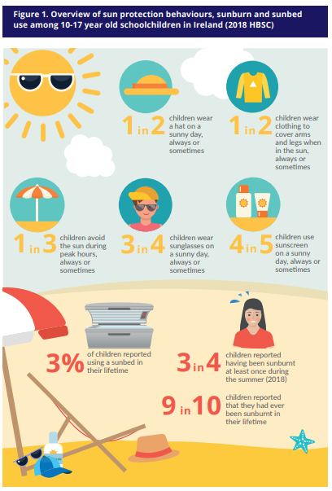
Results: UV Risk Behaviours 10-17 year olds (HBSC 2018)

Slide 8
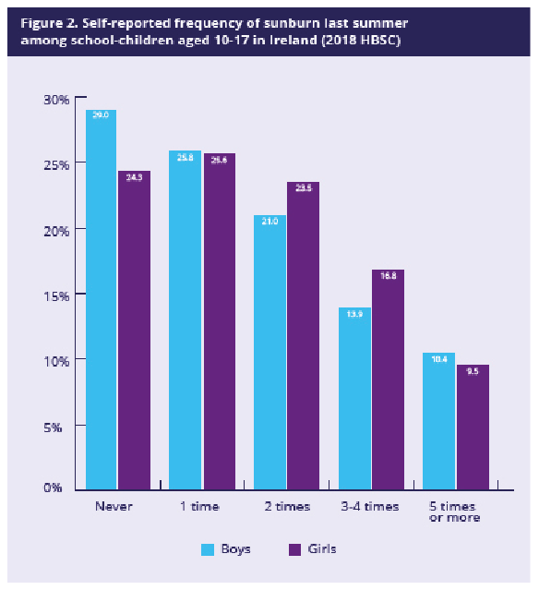
Sunburn – Last Summer
Higher social classes more likely to report sunburn both last summer and over lifetime
Notes:
The frequency of sunburn episodes, both during last summer and lifetime, accumulated with age: younger children were more likely than older children to report no sunburn or experienced it once or twice, while older children were more likely than younger children to report five or more sunburn episodes

Slide 9
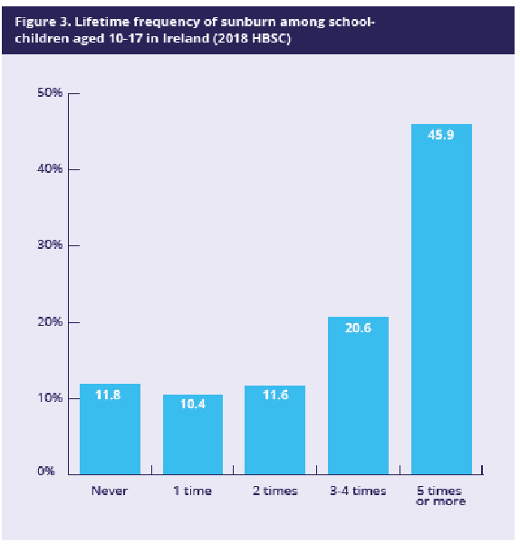
Sunburn - Lifetime
Girls more likely to report sunburn last summer but not over lifetime
Notes:
Girls are more likely to report sunburn last summer but not over a lifetime. No significant gender differences. There was a social class difference, with children from more privileged families reporting a higher prevalence of sunburn.
The frequency of sunburn episodes, both during last summer and lifetime, accumulated with age: younger children were more likely than older children to report no sunburn or experienced it once or twice, while older children were more likely than younger children to report five or more sunburn episodes

Slide 10
Additional data to inform sunburn figures
Data Source | Findings
Hospital In-Patient Enquiry | There were no data available on primary care consultations for childhood sunburn. Annual hospital discharges (adults and children) for diagnosis of sunburn (ICD-10-AM code ‘L55: Sunburn’) ranged from 6 – 15 cases of per year from 2006 – 2017. The exceptions were 2011 and 2015 when frequencies were less than five.
Growing Up in Ireland National Longitudinal Survey of Children - Cohort 1998 | Among 17–18-year-olds, 13.5% identified as Fitzpatrick type I; 33.6% identified as Fitzpatrick type II; 38% identified as Fitzpatrick III, 13% identified as Fitzpatrick IV; 1.5% identified as Fitzpatrick V; less than 1% identified as Fitzpatrick VI. This indicates a high level of population vulnerability to future skin cancer.
Notes:
HIPE DATA: International estimates suggest that one-third of total hospital admissions for sunburn are adolescents and young adults in the age range 10 to 19 years, suggesting they are a high-risk group for severe sunburn episodes (15, 16).
Fitzpatrick Scale: I is the fairest and VI is the darkest

Slide 11
Results: Sunbed use
Girls and children from lower social class groups were most likely to report tanning bed use than boys and those from higher social class groups, though the effect sizes were low.
Notes:
Most children had never used an indoor tanning bed, either in the last 12 months or in their lifetime (95%), and most of those who did report doing so once.
Using an indoor tanning bed was significantly associated with gender (Table 2) and social class (Table 4), but not age (Table 3). Girls and children from lower social class groups were most likely to report tanning bed use than boys and those from higher social class groups, though the effect sizes were low
It is not clear whether this represents use in commercial or domestic environments. Providing a sunbed service to anyone under the age of 18 is a breach of the Public Health (Sunbeds) Act 2014.

Slide 12
Results: Circumstances of sunbed use
Girls were more likely than boys to report that these safety measures were never advised when they used an indoor tanning bed.
The age difference was primarily attributed to younger children being more likely than older children to report that they had not encountered any of the safety measures when they used an indoor tanning bed.
Circumstances of tanning bed use were not associated with social class
Notes:
Caution is warranted when analyising these results as the sample size is very small.
Differences by gender, age, and social class are statistically significant but generally small

Slide 13
Regulation of sunbed industry compliance
Irish Cancer Society’s mystery shopper survey (2019), carried out by Ipsos MRBI across 40 tanning and beauty salons in Dublin​:
2 out of 5 operators offering sunbed sessions didn’t ask an underage person their age​.
2 in 5 did not ask for identification. ​
1 in 3 did not refuse to book minors​.
1 in 4 sunbed operators offered free sunbed minutes and 1 in 5 used two-for-one promotional offers​.
International evidence shows that the indoor tanning industry employs marketing strategies that downplay health risks, emphasize physical attractiveness, and target specific subgroups, including young women.
Notes:
Under current legislation, sunbeds cannot be provided for use by a commercial entity to anyone under the age of 18. Sunbeds emit UV-A radiation which penetrates the skin more deeply than other UV rays. This report found that a small proportion of children under 18 are using sunbeds, but we are not clear whether this use is occurring in home settings or commercial premises. H
The Public Health (Sunbeds) Act 2014 will be 10 years old in 2024, given the dramatic shifts in the operating context over the last 10 years. Revisiting and amending legislation to protect under-18s.

Slide 14
Policy Considerations
While sunscreen use overall was reasonably high among 10–17-year-olds, 90% reported experiencing sunburn.
Girls more frequently engaged with sunscreen, clothes that protect their arms & legs and avoid the sun between 12-3PM but they were more likely to engage in sunbed use.
Boys were less likely to wear sunscreen but reported wearing hats more than girls.
Older children were more likely than younger children to always wear sunglasses, always or sometimes wear protective clothing, but less likely than younger children to wear a hat, avoid sun between 12 and 3pm, or always use sunscreen
Notes:
These baseline patterns are broadly aligned with those from other countries [6–8, 14, 15]. They can inform assessments of population skin cancer risk posed by the exposure of children in Ireland to UV radiation.
Communication that sunscreen is last line of defence

Slide 15
Policy Considerations Con’t
Sunburn was reported more frequently among children in high and middle socio-economic groups. This pattern was observed in both last summer and lifetime experience of sunburn.
Girls and children from lower social class groups were most likely to report tanning bed use than boys and those from higher social class groups, though the effect sizes were low.
Foster diversity and inclusion in the imagery, messaging, and detection of skin cancer.
Notes:
Sunburn and sun holiday risks
international evidence shows that the indoor tanning industry employs marketing strategies which downplay health risks, emphasize physical attractiveness and target specific subgroups, including young women
Role here for beauty therapists, a lot of women get regular facials and cosmetic stuff is done but never see a dermatologist.

Slide 16
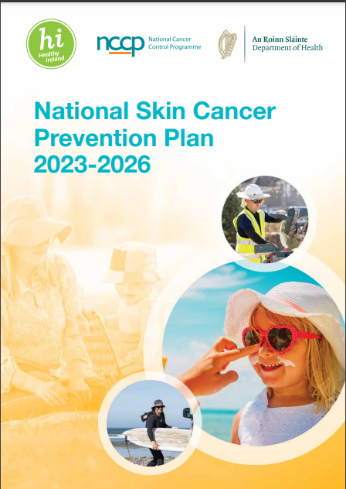
Gaps in evidence to support policy
Whether the sunburn that young people experience is mild, moderate or severe.
Whether children use sun protection appropriately (for example, do they use sunscreen with a high-enough factor and wear hats that cover their ears and necks?).
How children’s sun safety behaviour is influenced by their family, friends and school and by their experiences online.
How tanning and sunbeds are marketed and promoted to young people.
Longitudinal or trend data on UV safety behaviour (potential of including variables in the new wave of Growing up in Ireland to support monitoring of trends over time).

Slide 17
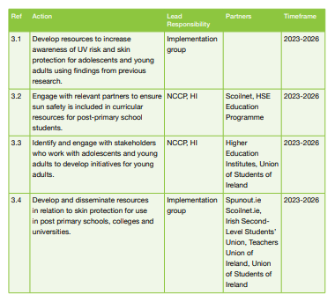
National Skin Cancer Prevention Plan 2023- 2026
Notes:
Moving into the new National Skin Cancer Prevention plan

Slide 18
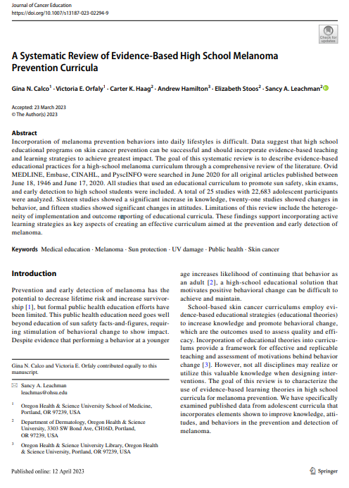
New Research
Systematic Review level data suggest that secondary level educational programs on skin cancer prevention can be successful and should incorporate evidence-based teaching and learning strategies to achieve the greatest impact (Calco et al, 2023).
Discussing the effects of UV radiation on premature aging has been shown to have a specific motivational effect on the adolescent population to practice sunsmart behaviors.
Notes:
The review found that discussing effects of UV radiation on premature aging has been shown to have a specific motivational effect on the adolescent population to practice sun safe behaviors
The Theory of Planned Behavior (TPB), Gamification (using game elements, Multimedia learning demonstrated improvement in short-term and long term health learning outcomes.

Slide 19
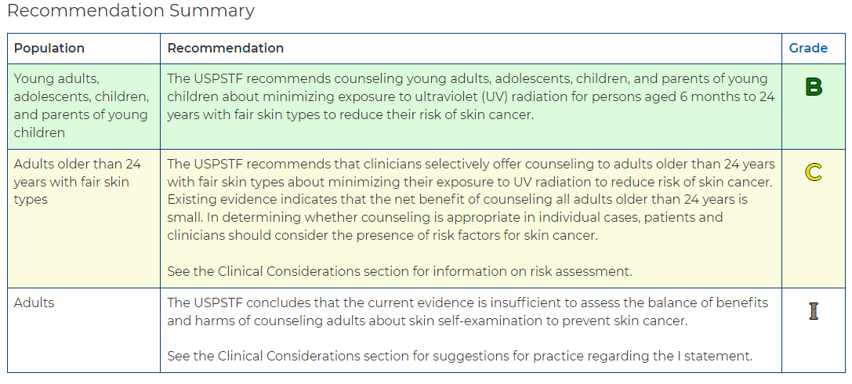
US Preventative Services Task force: Behavioral Counseling
Notes:
US Preventative Services Task force, Behvavioral Counselling - https://www.uspreventiveservicestaskforce.org/uspstf/recommendation/skin-cancer-counseling#fullrecommendationstart
The USPSTF found adequate evidence that behavioral counseling interventions available in or referable from a primary care setting result in a moderate increase in the use of sun protection behaviors for persons aged 6 months to 24 years with fair skin types.
The USPSTF found adequate evidence that behavioral counseling interventions available in or referable from a primary care setting result in a small increase in the use of sun protection behaviors for persons older than 24 years with fair skin types.
The USPSTF found insufficient evidence regarding the benefits of counseling adults about skin self-examination to prevent skin cancer.

Slide 20
Acknowledgements
Professor Saoirse Nic Gabhainn, HBSC Principal Investigator
Dr. András Költő, HBSC Researcher & Co-author on report
Colleagues at IPH, Dr Helen McAvoy and Leah Friend

Slide 21
Thank you
Any questions?
Email : lauren.rodriguez@publichealth.ie
Web: www.publichealth.ie
www.twitter.com/publichealthie
21

